Slide 1

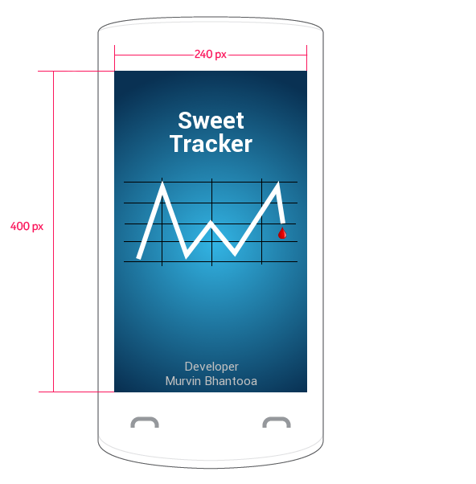
Sweet Tracker
Sweet Tracker is a blood sugar monitoring application designed to allow users to efficiently record their sugar levels, visualize the levels variations and effectively monitor their progress.
The application is secured via an optional PIN lock, supports 2 general themes and is translated in 5 languages.
Sweet Tracker is a brand new application created for the Asha Developer Competition. My motivation was to get the best performing and visually appealing application of its kind on the market place.

Slide 2
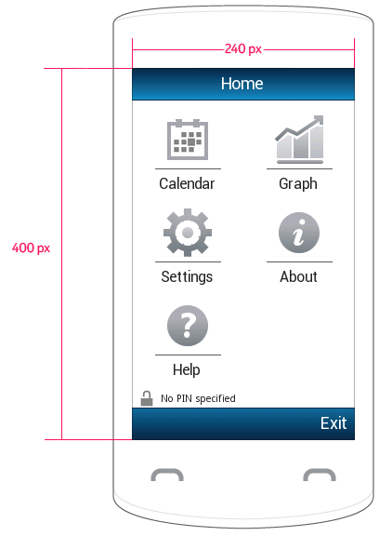

At a Glance
The home screen is loaded right after the application’s splash screen finishes. In case a PIN lock is set a dialog will appear prompting the user to authenticate before going any further. By default the lock is off.
This screen contains the application’s main menu. A central point where everything else is accessible. Here the user can add an entry through the calendar, edit the settings, get help to understand the app and view monthly graphs of all entries.
Murvin Bhantooa

Slide 3
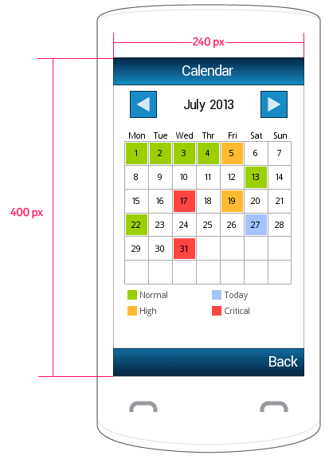
Calendar View
The calendar view…
Murvin Bhantooa

Slide 4
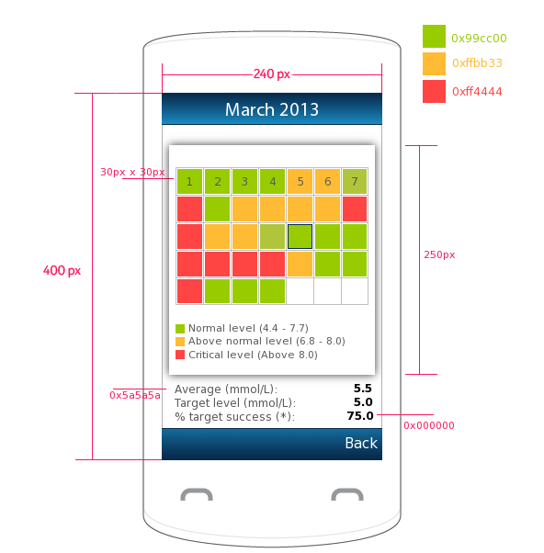
Adding an entry
The calendar view…
Murvin Bhantooa

Slide 5
Visualisations
The calendar view…
Murvin Bhantooa

